Slide 1
Research in Biomedicine and Health
Department of Research in Biomedicine and Health
3rd year medical programme

Slide 2
Vertically integrated course
Year 1: 50 h – acquiring knowledge and skills
Year 2: 25 h – applying knowledge and skills
Year 3: 25 h – evidence-based medicine

Slide 3
RBH, year 3
Aim of the course:
Learn how to find and assess evidence from research studies so that they can be effectively applied in clinical practice
Quickly find answers to clinical questions

Slide 4
RBH, year 3
Exam and grade?

Slide 5
RBH, year 3
Exam and grade:
1. Colloquium
3. Practical 1
4. Written test, 20 questions
Total: 50 points, 56% pass – 2 ECTS
More at the web-pages of the Department
10 points
20 points
20 points

Slide 6
RBH, year 3
Medicine is a science of uncertainty and an art of probability.
Sir William Osler

Slide 7
Evidence-based medicine
Course: Research in Biomedicine and Health III

Slide 8
Purpose
How to make the BEST decision for patient’s health care?
Elements of clinical decision:
Clinical decision
Health care system - rules
Patient’s values – wishes and expectations
Fear of malpractice lawsuits
Physician’s knowledge – evidence, skills, attitudes

Slide 9
Problem
Archie Cochrane, 1972:
“Most of the decisions related to treating patients are based on:
Ad hoc selection of information from huge and variable scientific literature
Opinion of experts
Or, the worst, by trial and error.”

Slide 10
Problem
Tom Chalmers, leader in clinical trials, 1995:
"The first 2 years of medical school have got to be changed. Students are spending more and more time understanding the difficult aspects of molecular biology, but we are kidding ourselves to think they use their knowledge of DNA – in my day it was the Krebs cycle - in making clinical decisions at the bedside. They do not. They make clinical decisions based on how the last patient did, how their friends are treating patients and what the latest article by an authority says they should do. And we have got repeated evidence now that the authorities are way behind with regard to the data in clinical trials. In medical school, I think we have to just hammer away at evidence and probability theory and general statistics."

Slide 11
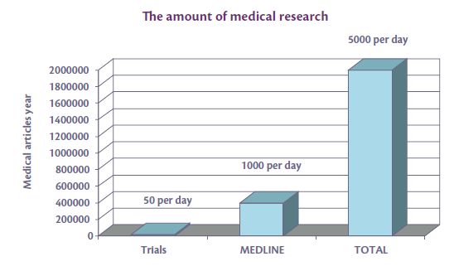
Why does this happen?
Gap between research and clinical practice
Clinicians are not aware of the result of most published studies or they have no way to test the quality of these results.
Researchers write their papers in a way that is not easily understood by busy clinicians.

Slide 12
Give us a tool!
Clinicians need a tool:
by which they can assess the outcomes
of individual studies,
2. which will help them overcome the problem of large number of published.
The tool: evidence-based medicine (EBM)

Slide 13
Evidence-based medicine
Evidence-based medicine is the conscientious, explicit and judicious use of current best evidence in making decisions about the care of individual patients.

Slide 14
Burn your books!
David Sackett, EBM “father”

Slide 15
Advice from Dave Sackett, the father of evidence based medicine
The most powerful therapeutic tool you’ll ever have is your own personality
Half of what you’ll learn in medical school will be shown to be dead wrong or out of date within five years of your graduation; the trouble is that nobody can tell you which half — so the most important thing to learn is how to learn on your own
Remember that your teachers are as full of bullshit as your parents
You are in for more fun than you can possibly imagine

Slide 16
Two principles:
Clinical decision making is base on a hierarchical pyramid of evidence strength from different study designs.
Evidence by itself is not enough for the final decision – the physician must always consider benefits and risks, price and many other parameters, especially subjective characteristics and value system of the patient.

Slide 17
Sources of clinical excellence
Personal knowledge of the physician
Clinical experience
Collaboration with colleagues
EBM tools:
Standard operating procedures
Protocols
Guidelines
Algorhythms
Current best available evidence from literature

Slide 18
Characteristics of good quality sources
Validity (contain quality data)
Relevance (can be used in clinical practice)
Comprehensibility ( contain information about benefits and harm of all possible interventions)
Availability (use is simple, easy and fast)

Slide 19
Standard operating procedure (SOP)
An official, detailed, written instruction to achieve uniformity of the performance of a specific function.
Benefits are reduced work effort, along with improved data comparability, credibility and legal defensibility
Example – SOP for medical procedures and evacuation of the Croatian Centre for Demining.

Slide 20
Protocol
Detailed specific insgtructions for a specific clinical decision.
May have legal weight.
Different types of protocols: e.g., for therapy, procedures, referrals, clinical trials.

Slide 21
Guideline
Describes a spectrum of generally accepted approaches to diagnosis, treatment and prevention of diseases and conditions.
Created as a consensus of experts after detailed evaluation and assessment of available scientific evidence.
Aim to improve patient care.
Examples: The National Guideline Clearinghouse (NGC) (www.guideline.gov); National Institute for Health and Clinical Excellence (NHS) (www.nice.org.uk)

Slide 22
Algorhythm
Sequence of clinical decision in the care of a single patients.
Usually in the form of flow diagram.
Aim to standardise medical decision making in the provision of medical care.

Slide 23
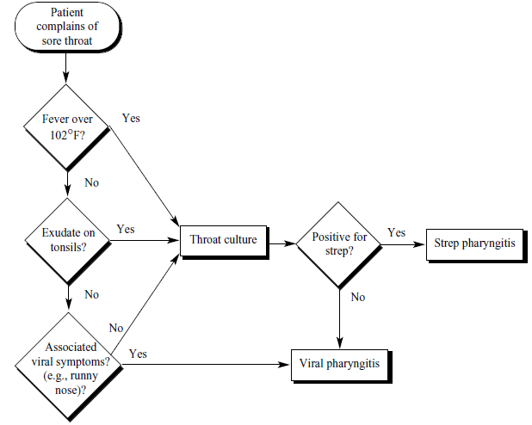

Slide 24
Best available evidence from scientific literature
Problem: information overload
5,000
per day
Articles/year
1,500 per day
100 per day

Slide 25
Hierarchy of information sources for evidence-based decision making
IT systems
EBM textbooks
Secondary publications (EBM journals)
Systematic reviews
Original research articles
Systems
Summaries
Synopses
Syntheses
Studies

Slide 26
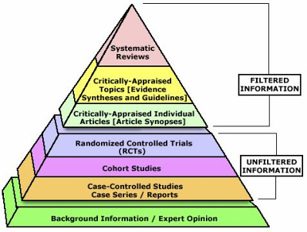
Hierarchy of information sources for evidence-based decision making

Slide 27
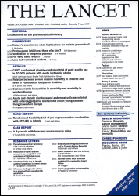
Original research articles
Scientific journals
Bibliographical databases
www.tripdatabase.com

Slide 28
Systematic reviews
Cochrane Database of Systematic Reviews (CDSR)
Database of Abstracts of Reviews of Effects (DARE)

Slide 29
Secondary publications (EBM journals)
Systematically search relevant medical journals for methodologically rigorous and clinically important original research studies.
Results of these studies are critically evaluated and presented as structured abstracts.
Usually not in open access:
ACP Journal Club (www.acpjc.org)
Evidence-Based Medicine (ebm.bmjjournals.com)
Evidence-Based Mental Health (http://ebmh.bmjjournals.com)
Evidence-based Obstetrics and Gynecology
Free access:
Bandolier (http://www.medicine.ox.ac.uk/bandolier)

Slide 30
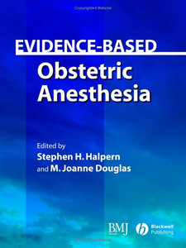
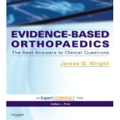
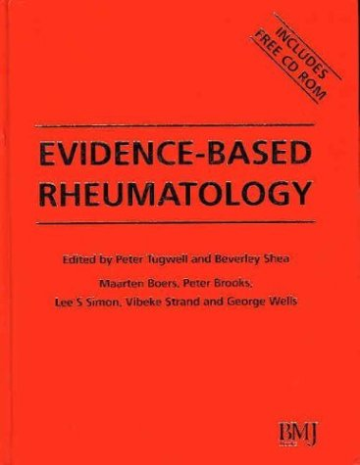
EBM textbooks

Slide 31
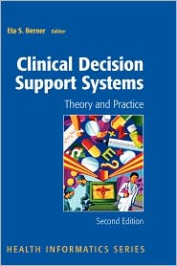
IT systems
Integration of medical evidence and information technology.
Systems for support in clinical decision making.

Slide 32
Levels of evidence
N of1 RCT
Systematic review of RCTs (w or w/o metaanalysis)
Individual RCT
Systematic review of observational studies
Individual observation study
(cohort, case-control, cross-sectional study )
Physiological study
Non-systematic clinical observations

Slide 33
“Evidence-based medicine is the integration of best available evidence with clinical expertise and patient values”” – Dave Sackett
Patient values
Best research evidence
Clinical practice

Slide 34
What is EBM in practice?
How to formulate a clinical question?
Learn how to find answers
Use the answers for clinical decision making

Slide 35
What is EBM in practice?
EBM steps
Step 1: Formulating questions that can be answered
Step 2: Finding best evidence
Step 3: Quick critical assessment of the evidence
Step 4: Applying evidence
Step 5: Assessing effectiveness and efficiency of the process

